Slide 1



Data Engineering Pipeline for Student Performance Prediction
University of New Haven
DSCI-6007-02 | TEAM 8

Slide 2



University of New Haven
TEAM MEMBERS
BIPIN PURI Data Engineer
Greeshma Chanduri
ML Engineer
Dipa Khadka Cloud Engineer

Slide 3







University of New Haven
INTRODUCTION
GOALS OF THE PROJECT
PROJECT ARCHITECTURE
PROJECT DETAILS
ETL Pipeline (AWS Glue PySpark), AUTOMATION
MODEL DEPLOYMENT

Slide 4
University of New Haven
INTRODUCTION
• Educational institutions struggle with late identification of at-risk students.
• Manual systems fail to scale and lack real-time insights.
• Our solution: a fully automated, event-driven, serverless AWS pipeline that processes raw CSV → delivers predictions < 3 minutes.
• Enables proactive intervention using real-time predictions + explainability.

Slide 5
University of New Haven
GOALS
• Build an end-to-end serverless data engineering pipeline using AWS Free Tier
• Automate ingestion → processing → transformation → inference with zero manual steps
• Achieve ≥92% prediction accuracy using a hybrid ensemble ML model
• Deploy a real-time prediction API using FastAPI on EC2
• Provide interpretable predictions using SHAP
• Deliver a Streamlit web app for educators

Slide 6
University of New Haven
DATASET AND PREPROPROCESSING
DATASET OVERVIEW
• UCI Student Performance Dataset
• 395 records, 33 features (demographic, behavior, academics)
TARGET
• G3 binned into: Low (0–9), Medium (10–14), High (15–20)
PREPROCESSING IN AWS GLUE
• Automated PySpark ETL:
– Label Encoding
– Standard Scaling
– Derived features (Dalc + Walc combined alcohol consumption)
– G3 binning
• Data Quality Checks: nulls, duplicates, invalid ranges
• Writes Snappy-compressed Parquet partitioned by school/year/month
• Glue Crawlers perform schema inference & evolution

Slide 7
University of New Haven
DATA ENGINEERING PIPELINE
Data Ingestion:
• Student CSV uploaded to S3 Raw Zone
• S3 triggers EventBridge → starts pipeline
Data Processing:
• Glue Workflow orchestrates Crawler + ETL job
• PySpark job performs cleaning, transformation, validation
• Output stored as partitioned Parquet (10–12× compression)
Data Serving:
• Athena + Glue Catalog enable querying
• Streamlit app fetches predictions via FastAPI API

Slide 8
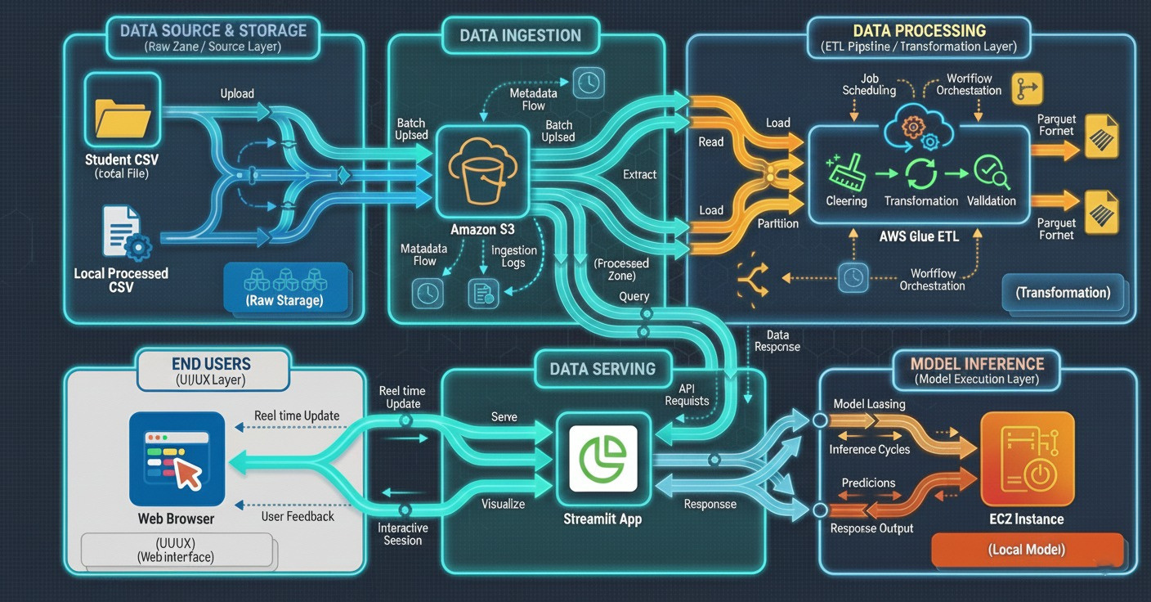
University of New Haven
ARCHITECTURE DIAGRAM OF THE SOLUTION

Slide 9
University of New Haven
EXPECTED DELIVERABLES
• Automated AWS Data Engineering Pipeline (serverless, event-driven)
• Medallion Lakehouse Architecture with Raw, Processed, and Consumption layers
• Hybrid Ensemble Prediction Model (92.4% accuracy)
• FastAPI EC2 endpoint for real-time predictions
• Streamlit web interface with single + batch predictions
• Explainability via SHAP plots
• Open-source GitHub repository

Slide 10



University of New Haven
‹#›
THANK YOU

